Slide 1
Managing at risk challenging Behavior
Crisis as Opportunity
Notes:
Welcome
Framing the Webinar:

Slide 2
Take a moment
Notes:
Reflect upon:
How do you perceive behaviors that are challenging you?
Pause 1minute
Joanne note
Students who display intense behaviors can:
Interrupt instruction
Challenge adult authority
Create unsafe classroom and school environments

Slide 3
Challenging behaviors
Any repeated pattern of behaviors or perception of behavior that interferes or is at risk of interfering with optimal learning or engagement with pro-social interactions with peers and adults.

Slide 4
Challenging behaviors

Slide 5
Crisis is…
When a student’s inability to cope results in a change in behavior.
Notes:
Note: Student and young person will be used interchangeably in the remaining content

Slide 6
Crisis as Opportunity…
Notes:
In Chinese, the word “Crisis” is composed of 2 characters:
‘Wei”-indicates a critical or dangerous situation
“Ji”-an opportunity for change
Setting Conditions- anything that makes challenging behavior less likely to occur
Physical environment
Is it calming or stressful
Temperature , noise level or lighting effects the stress level in room.

Slide 7
How it starts crisis Cycle
Stressful incident or situation
Student’s feelings
Student’s behavior
Adult response

Slide 8
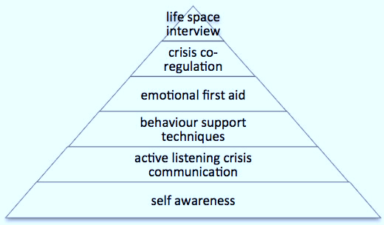
Crisis response strategies

Slide 9
Understanding stress

Slide 10
Pre-Crisis State (Calm)
Behavioral Indicators | Interventions
Able to cooperate and follow directions | Provide clear consistent expectations with consistent praise
Responsive to praise and reinforcement | Provide engaging interactions
Able to make an error and receive correction | Positive and predictable environment
Less likely to react | Teach and practice social skills and coping skills

Slide 11
Trigger Phase (Agitation)
Behavior Indicators | Interventions
Increase or decrease in body/eye/hand movements | Provide quiet space or alone time
Distracted; unfocused | Teacher supports (provide assurance)
Bothering others | Provide extended time
Questioning or arguing | Adult proximity
Avoidance or escape (not willing to follow directions) | Give choices in activities
Withdrawal (no speech or eye contact) | Change expectations

Slide 12
Escalation Phase (Aggression)
Behavioral Indicators | Interventions
Defiance | Maintain calm
Physical or verbal aggression | Avoid escalating prompts
Property destruction | Use proximity (respect student space)
Self-abuse | Time away with staff support
Leaving area | Crisis communication

Slide 13
Outburst Phase (Violence)
Behavioral Indicators | Intervention
Physical aggression immediate danger to self or others | Implement crisis plan
Verbal aggression threats towards others | Remove potential triggers, targets, weapons
Property damage | Allow safe personal space
Self-abuse | Speak very little

Slide 14
Recovery Phase (calm)
Behavioral Indicators | Intervention
Calm body language | Allow time and space for recovery
Able to communicate to others | Teach new coping skills Life Space Interview (LSI)
Cooperate willingness to resume task | Return with support and praise to normal activity

Slide 15
Goals of Life Space interview
Return student to baseline (calmness)
Clarify events
Repair and restore relationship
Teach new coping skills
Return student to classroom or routine

Slide 16
Life Space interview- I Escape
I = Isolate the conversation
E = Explore students point of view
S = Summarize their feeling
C = Connect feelings to behaviors
A = Alternative behaviors
P = Practice new behavior
E = Enter back into routine

Slide 17
Moving forward
Quote:
When I was 5 years old, my mother always told me “happiness” was the key to life.
When I went to school, they asked me what I wanted to be when I grew up and I wrote down ”HAPPY”.
They told me I didn’t understand the question and I told them they didn’t understand “LIFE”.
-John Lennon-
Notes:
Reflection
Take a Moment to reflect on how you perceive student who are defiant or non-compliant..
They interrupt instruction
Do poorly academically
Challenge adult authority
Create unsafe classroom & school environments
Show little motivation to learn or be a part of the school community
They are the most challenging to teach and to reach….

Slide 18
Brought to you by:

